Slide 1

PRESENTATION on MARKET PRICE PREDICTION
KHAN MD SHIBLI NOMANI
email: kmshiblinomanii@gmail.com
LinkedIn: https://www.linkedin.com/in/khan-md-shibli-nomani-45445612b/
whatsApp: +8801672403057
Github: https://github.com/Shibli-Nomani
kaggle: https://www.kaggle.com/shiblinomani

Slide 2
OBJECTIVES
Introduction to Market Price Prediction
How do the ML and DL Models help in Market Price Prediction
About Dataset
Model Building Workflow
Limitations and Improvements
Impact on Business
Costing and Return
Conclusion

Slide 3

Introduction to Market Price Prediction
Market price prediction involves forecasting the future prices of commodities or assets based on historical data and predictive models. It aims to provide valuable insights for decision-making, such as investment strategies, inventory management, and pricing policies, by leveraging statistical analysis, machine learning, and deep learning techniques.

Slide 4

How do the ML and DL Models help in Market Price Prediction
ML and DL models analyze historical market data to identify patterns and trends, allowing businesses to predict future price movements more accurately.
These models can capture complex relationships between factors influencing prices, such as supply and demand dynamics, economic indicators, and external factors like weather conditions or geopolitical events.
ML and DL algorithms continuously learn from new data, enabling them to adapt to changing market conditions and provide updated predictions in real time, helping businesses make timely and informed decisions.
By incorporating ML and DL models into their pricing strategies, businesses can optimize inventory management, minimize risks, maximize profits, and gain a competitive edge in the market.

Slide 5
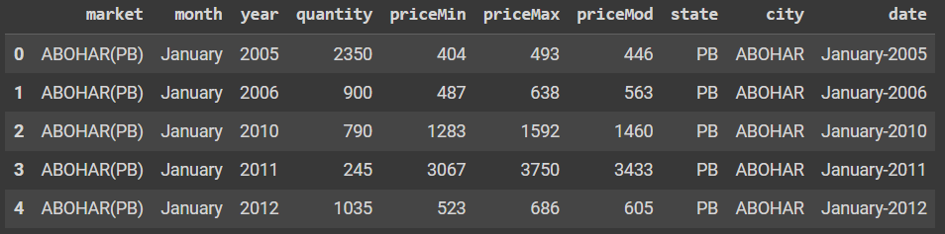
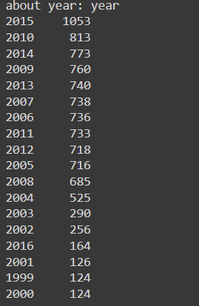
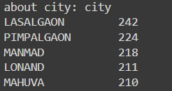
ABOUT DATASET
Dataset Overview:
The dataset contains 10 columns and 10227 entries.
It includes information about market transactions recorded over time.
City Distribution:
The dataset covers various cities, with the top five being Lasalgaon, Pimpalgaon, Manmad, Lonand, and Mahuva.
Lasalgaon has the highest frequency of entries, with 242 records.
Year Distribution:
The dataset spans multiple years, with the most extensive data available for the year 2015, comprising 1053 entries.
Other prominent years include 2010, 2014, 2009, and 2013, with 813, 773, 760, and 740 entries, respectively.
The earliest recorded data dates back to the year 1999, with only 124 entries, indicating a progressive accumulation of data over time.

Slide 6
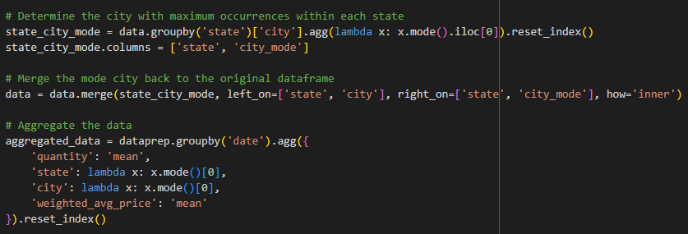
Workflow
Data Loading
Data Analysis and Preprocessing
Seasonal Analysis
Model Selection
Remove Duplicates, Missing
Values
Augmented Dicky Fuller Test
ARIMA, SARIMAX,
PROPHET,LSTM
Outliers Detection and Removal
ACF(Auto Correlation Function)
Data Visualization
PACF(Partial Auto Correlation Function)
Numerical Representation
Drop Unnecessary Cols and Apply
Aggregation
Model Evaluation
Model Comparision
Final Model
MAE, MSE, RMSE

Slide 7
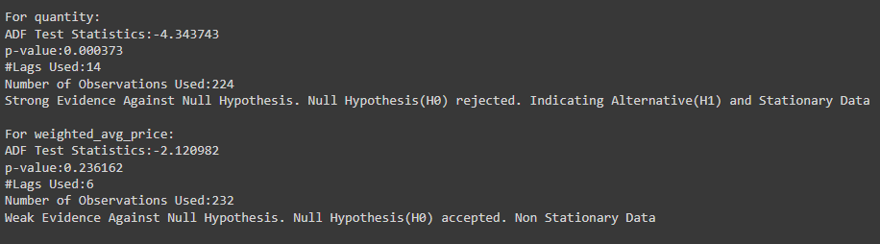
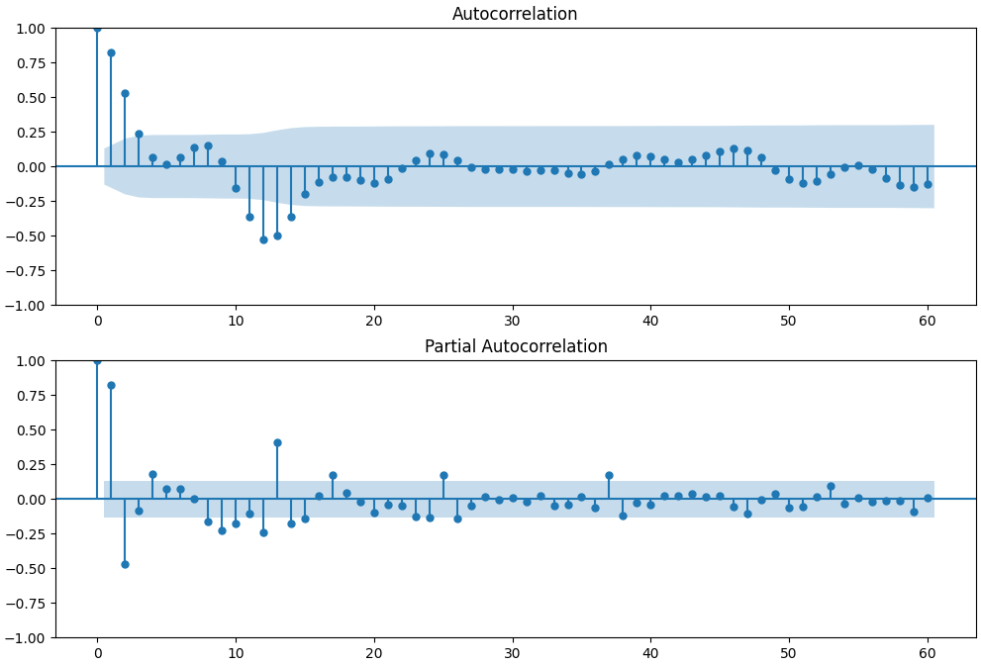
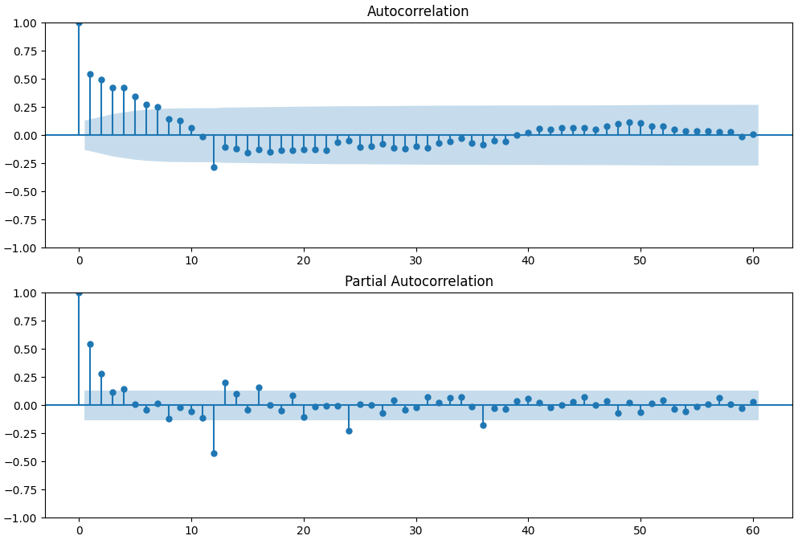
ADFuller Test, ACF, PACF
ADFULLER Test
Weighted Avg Price (ACF & PACF)
Quantity (ACF & PACF)

Slide 8
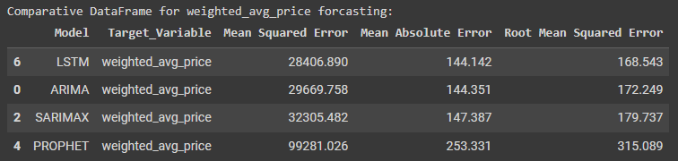
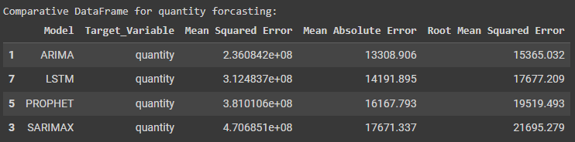
Comparison of Different Models
Weighted Avg Price
Quantity

Slide 9

Model Performance and Improvements
LSTM demonstrates superior performance in price forecasting, while ARIMA excels in quantity forecasting. Enhancements in model performance can be achieved through fine-tuning, increasing data volume, conducting extensive exploratory data analysis (EDA), and refining preprocessing techniques. Additionally, incorporating more diverse test data can further refine model accuracy. A combined approach leveraging both LSTM and ARIMA models can potentially yield robust performance, particularly in price forecasting and quantity forecasting.
Moreover, employing various aggregation methods like sum, mode, median, and demographic integration across different variables can further enhance forecasting accuracy and robustness.

Slide 10

Business Impact
Business Impact: Market price predictive models enable businesses to make data-driven decisions regarding production, procurement, pricing strategies, and resource allocation. By accurately forecasting market trends, businesses can optimize inventory management, minimize costs, and maximize profitability.
Applications: Market price predictive models find applications across various industries, including agriculture, finance, retail, and manufacturing. These models assist in predicting commodity prices, stock market trends, consumer demand, and resource availability, empowering businesses to adapt to market dynamics effectively and stay ahead of the competition.

Slide 11

Costing and Returns
Costing: Developing and implementing market price predictive models involves upfront costs in data acquisition, model development, infrastructure setup and human resources along with ongoing expenses for maintenance and updates.
Returns: However, the returns are significant, with businesses enjoying reduced forecasting errors and optimized inventory management, leading to improved operational efficiency and increased profitability.

Slide 12
Conclusion
ML and DL offer powerful tools for market price prediction.
Integration of these techniques can lead to significant business advantages.
Strategic investment in ML and DL capabilities can drive long-term profitability and growth.

Slide 13
Thank You, Everyone
KHAN MD SHIBLI NOMANI

